Slide 1
Mapping to Database for information retrieval using ASP.NET
Faiq Malik
Vincent Wong

Slide 2
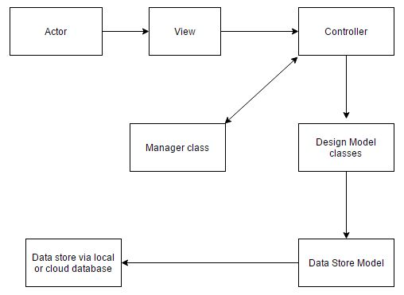
The Design Model

Slide 3
How is the data sent?
The process is started after the user interacts with the browser and clicks on a list item or an object on the View.
The browser records the click instance and sends the data back to the server.
The data is then processed by the controller which then packages it and sends it.
The packaged data is then sent to the design model class for specific data retrieval.
When the data store model is made, it will filter the data which is to be displayed to the user using LINQ.
This process is completed using HTTP POST method inside the browser which is INPUT.

Slide 4
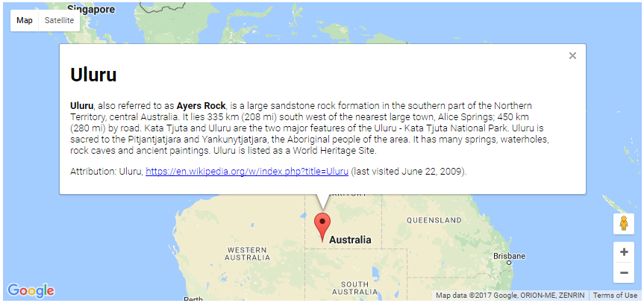
Example
Image Source:https://developers.google.com/maps/documentation/javascript/examples/infowindow-simple

Slide 5
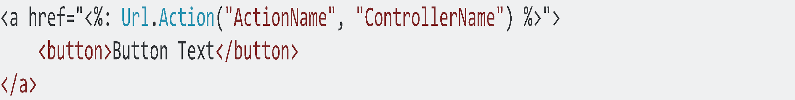
Code Snippet
ActionName:
The action that is to be done by the user i.e. a click.
ControllerName:
The controller that handles the action and processes data if it’s sent along with the action.

Slide 6
What is LINQ? (Language INtegrated Query)
This facility within ASP.NET framework acts similarly to SQL.
Used to filter or sort data as required by the user.
Can get either a collection of items or just one.
Can provide add, remove, update and select queries.
The queries are executed only when the data is used and it is not executed at the data store.

Slide 7
The Manager Class
It is another controller.
Handles all the business and app logic.
Its purpose is to manage the flow of information.
Used to handle data service operations which are used by all controllers.
Handles the reading, writing and saving of actual data.
Used to map data retrieved from database to models and view models.

Slide 8
How is the data retrieved?
The data reaches a controller and is filtered using LINQ in the Manager class which handles the flow of information from the data context database.
The manager class handles data and sends it back to the controller for further processing.
During this stage the data is retrieved using filter queries which get the data either in a list or as one object.
The retrieved data is sent back to a model and mapped accordingly to the view model which is to be displayed.
The view model is then rendered and displayed by the browser to the user.

Slide 9
References
https://petermcintyre.com/bti420/notes/jan18/
https://msdn.microsoft.com/en-us/library/bb308959.aspx
https://developers.google.com/maps/documentation/javascript/examples/infowindow-simple

